Slide 1
Chapter 1 - Identifying potential security threats

Slide 2
Content
What are the various security threats?
What is Confidentiality, Integrity and Availability (CIA) ?
What is Defence in Depth?

Slide 3
What are the various security threats?

Slide 4
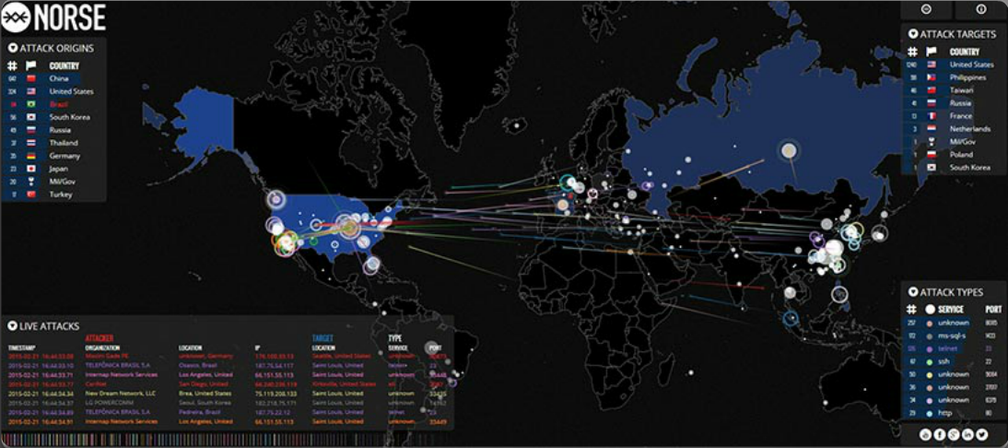
Networks Are Targets
Notes:
1.1.1.1 Networks Are Targets
http://map.ipviking.com/

Slide 5
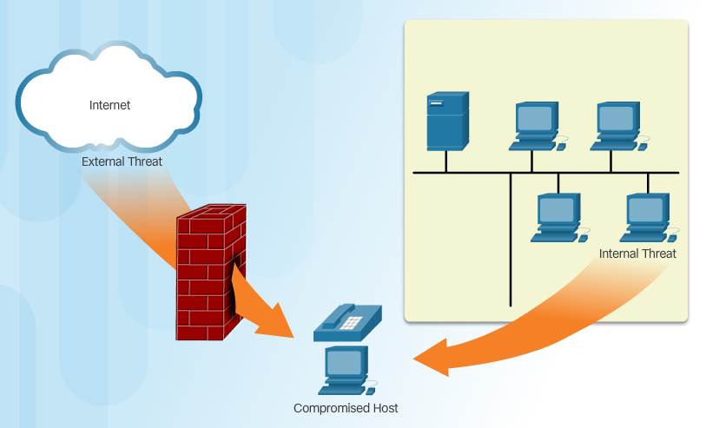
Vectors of Network Attacks
Notes:
1.1.1.3 Vectors of Network Attacks

Slide 6

The Hacker & The Evolution of Hackers
Modern hacking titles:
Script Kiddies
Vulnerability Brokers
Hacktivists
Cyber Criminals
State-Sponsored Hackers
Notes:
1.2.1.1 The Hacker
1.2.1.2 The Evolution of Hackers
1.2.1.3 Cyber Criminals
1.2.1.4 Hacktivists
1.2.1.5 State-Sponsored Hackers

Slide 7
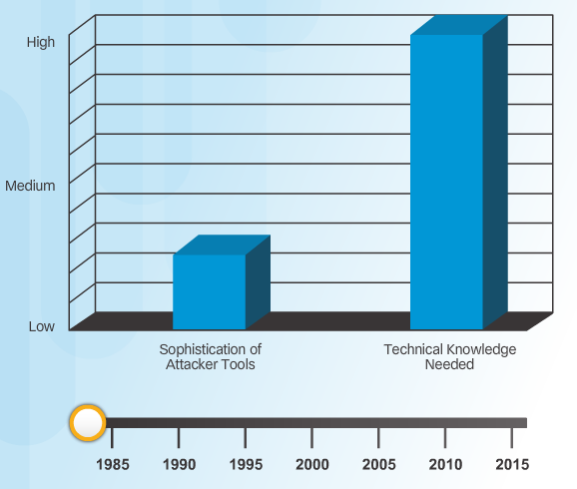
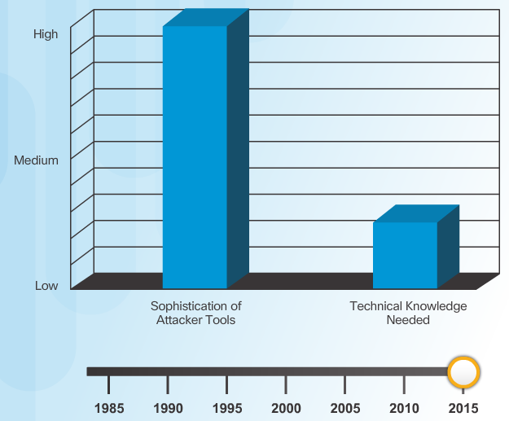
Introduction of Attack Tools
Notes:
1.2.2.1 Introduction of Attack Tools

Slide 8
Evolution of Security Tools
Penetration testing tools:
Password crackers
Wireless hacking
Network scanning and hacking
Packet crafting
Packet sniffers
Rootkit detectors
Fuzzers to search vulnerabilities
Forensic
Debuggers
Hacking operating systems
Encryption
Vulnerability exploitation
Vulnerability Scanners
Notes:
1.2.2.2 Evolution of Security Tools

Slide 9
Categories of Attack Tools
Network hacking attacks:
Eavesdropping
Data modification
IP address spoofing
Password-based
Denial-of-service
Man-in-the-middle
Compromised-key
Sniffer
Notes:
1.2.2.3 Categories of Attack Tools

Slide 10
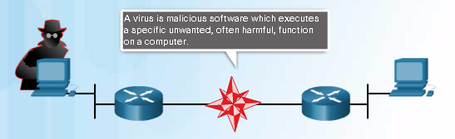
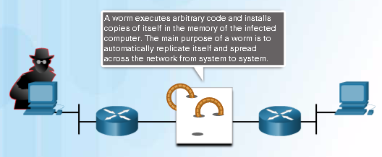
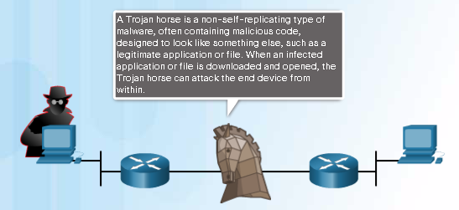
Various Types of Malware
Notes:
1.2.3.1 Various Types of Malware

Slide 11

Viruses
Notes:
1.2.3.2 Viruses

Slide 12
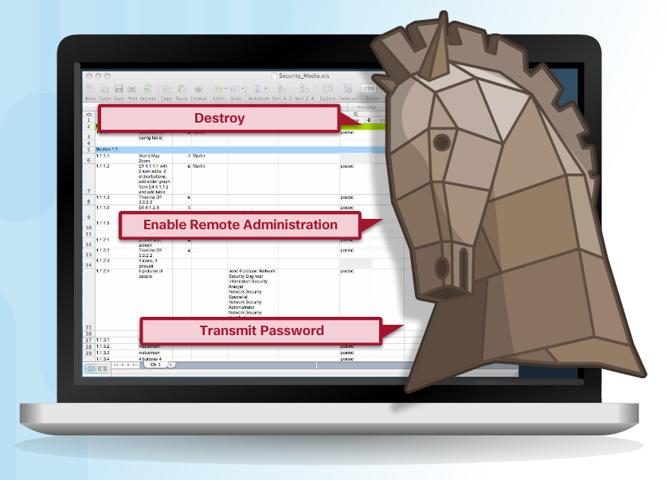
Trojan Horse Classification
Classifications:
Security software disabler
Remote-access
Data-sending
Destructive
Proxy
FTP
DoS
Notes:
1.2.3.3 Trojan Horses
1.2.3.4 Trojan Horse Classification

Slide 13
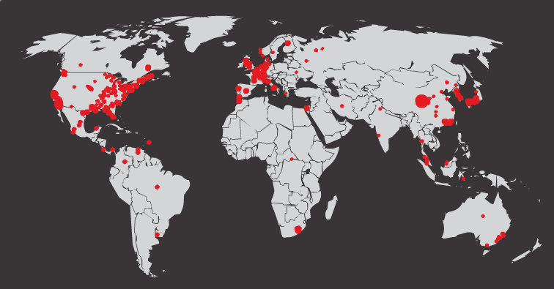
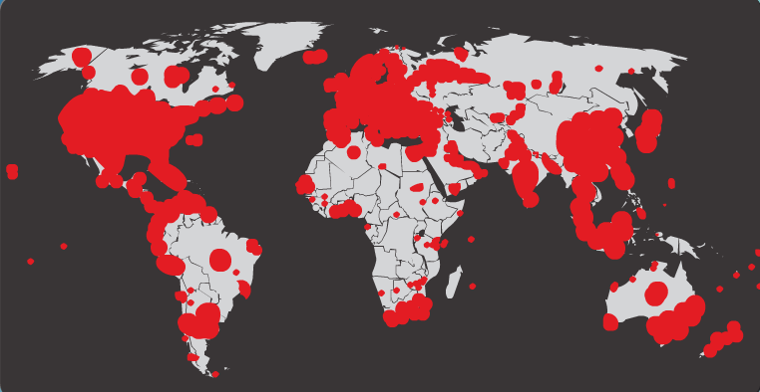
Worms
Initial Code Red Worm Infection
Code Red Worm Infection 19 Hours Later
Notes:
1.2.3.5 Worms

Slide 14
Worm Components
Code Red Worm Propagation
1.
Propagate for 19 days
2.
Launch DoS attack for next 7 days
3.
Stop and go dormant for a few days
4.
Repeat the cycle
Components:
Enabling vulnerability
Propagation mechanism
Payload
Notes:
1.2.3.6 Worm Components

Slide 15
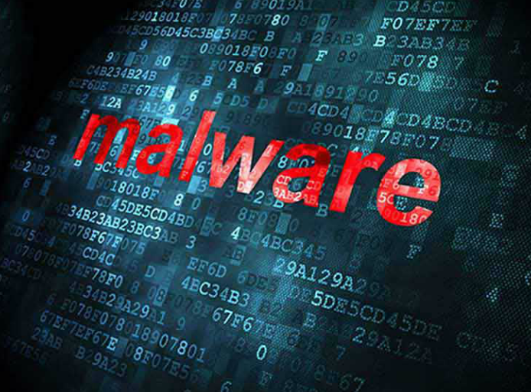
Other Malware
Ransomware
Spyware
Adware
Scareware
Phishing
Rootkits
Notes:
1.2.3.7 Other Malware
1.2.3.8 Activity - Identify the Malware Type

Slide 16
Types of Network Attacks
Data Modification
Syn Flood
Smurf Attack
Reconnaissance
Access
DoS
Notes:
1.1.1.1 Networks Are Targets

Slide 17

Reconnaissance Attacks
Initial query of a target
Ping sweep of the target network
Port scan of active IP addresses
Vulnerability scanners
Exploitation tools
Notes:
1.2.4.2 Reconnaissance Attacks
1.2.4.3 Sample Reconnaissance Attacks

Slide 18
Access Attacks
A few reasons why hackers use access attacks:
To retrieve data
To gain access
To escalate access privileges
A few types of access attacks include:
Password
Trust exploitation
Port redirection
Man-in-the-middle
Buffer overflow
IP, MAC, DHCP spoofing
Notes:
1.2.4.5 Access Attacks
1.2.4.6 Types of Access Attacks

Slide 19
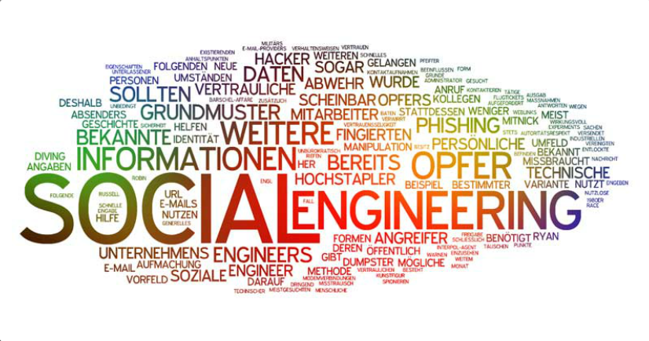
Social Engineering Attacks
Pretexting
Phishing
Spearphishing
Spam
Tailgating
Something for Something
Baiting
Notes:
1.2.4.6 Social Engineering

Slide 20
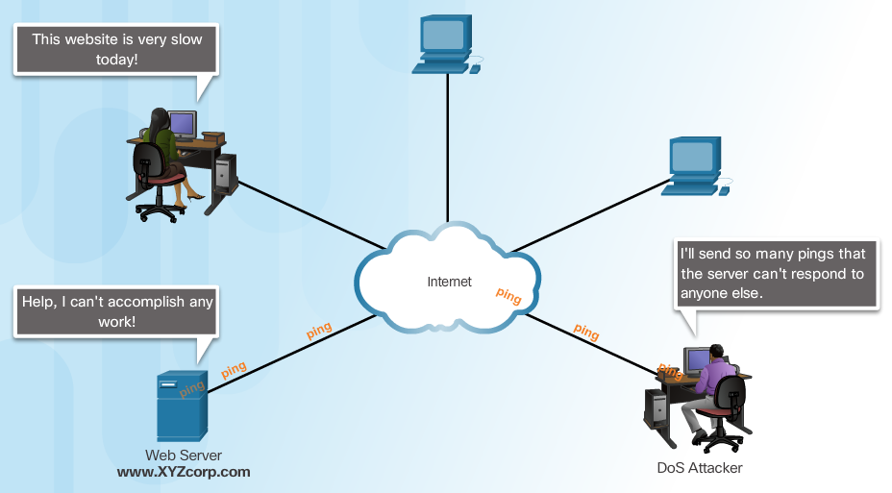
Denial of Service Attacks
Notes:
1.2.4.7 Denial of Service Attacks
1.2.4.8 Types of DoS Attacks

Slide 21
DDoS Attacks
Hacker builds a network of infected machines
  A network of infected hosts is called a botnet.
  The compromised computers are called zombies.
  Zombies are controlled by handler systems.
Zombie computers continue to scan and infect more targets
Hacker instructs handler system to make the botnet of zombies carry out the DDoS attack
Notes:
1.2.4.9 DDoS Attacks
1.2.4.10 DDoS Attacks (cont.) - Video https://www.youtube.com/watch?v=NogCN78XN2w
1.2.4.11 Activity - Identify the Types of Attack
1.2.4.12 Lab - Social Engineering

Slide 22
What is Confidentiality, Integrity and Availability (CIA) ?

Slide 23
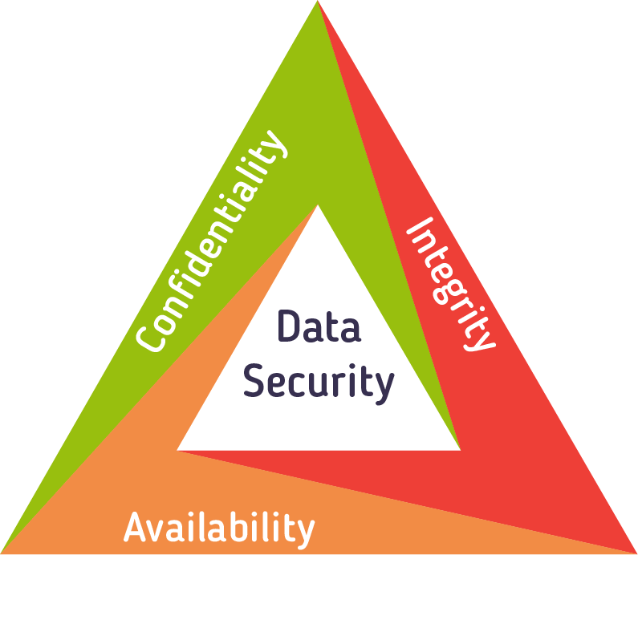

Slide 24
The classic model for information security
Each objective addresses a different aspect of providing protection for information
Confidentiality refers to protecting information from being accessed by unauthorized parties. In other words, only the people who are authorized to do so can gain access to sensitive data.
Integrity refers to ensuring the authenticity of information—that information is not altered, and that the source of the information is genuine.
Availability of information refers to ensuring that authorized parties are able to access the information when needed.

Slide 25
What is Defence in Depth?

Slide 26
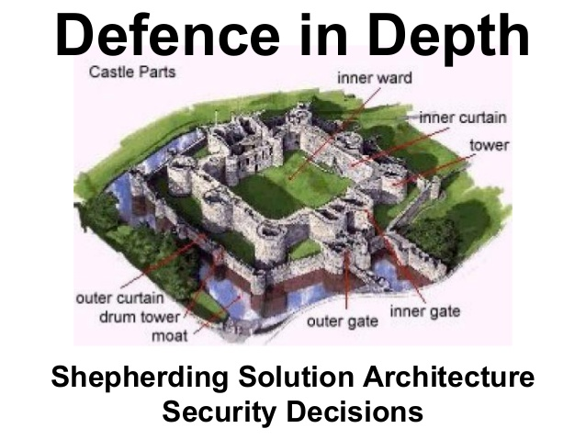

Slide 27
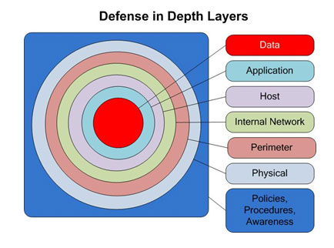

Slide 28
The use of multiple layers of defense placed throughout an information system.
With multiple layers the outermost layers are the first line of defense and work well against the smallest and most common attacks.
More powerful and unconventional attacks get past the first few layers but will be stopped by the deeper, more concentrated layers.
No single point of failure, designed to delay or stop attacks

Slide 29
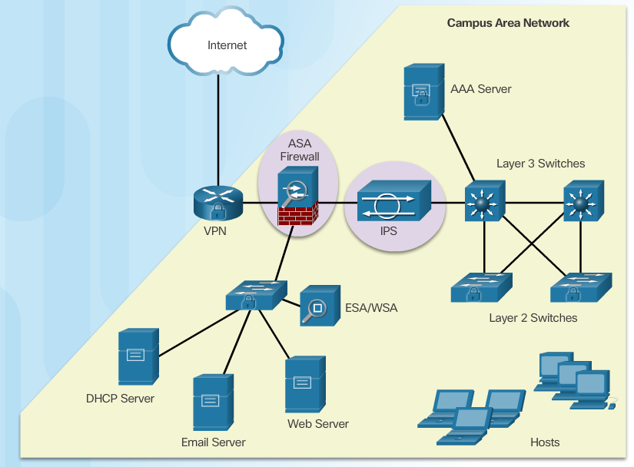

Slide 30
Examples of Defence in Depth Mechanisms
Firewall
DMZ
Authenticaion
IDS/IPS
VPN
Anti Virus and Anti Malware

Slide 31
Best practices:
Develop a written security policy.
Educate employees about the risks of social engineering, and develop strategies to validate identities over the phone, via email, or in person.
Control physical access to systems.
Use strong passwords and change them often.
Encrypt and password-protect sensitive data.
Implement security hardware and software.
Perform backups and test the backed up files on a regular basis.
Shut down unnecessary services and ports.
Keep patches up-to-date by installing them weekly or daily to prevent buffer overflow and privilege escalation attacks.
Perform security audits to test the network.
Notes:
1.3.4.1 Defending the Network

Slide 32
Research Activity (5%)
Form groups of 4 students
Submit group names and student names to lecturer
You are required to spend 2 hour to research on the Internet on the different mechanisms to implement defence in depth
Prepare a 20 slides presentation to go through each mechanism in brief
Restrict your presentation to 15 mins max

